Slide 1


WTO SPS Committee Work on MRLs
International Discussion on MRLs
Geneva, February 26-27, 2018
Julia Doherty
Deputy Assistant USTR for Agricultural Affairs
Office of the U.S. Trade Representative

Slide 2
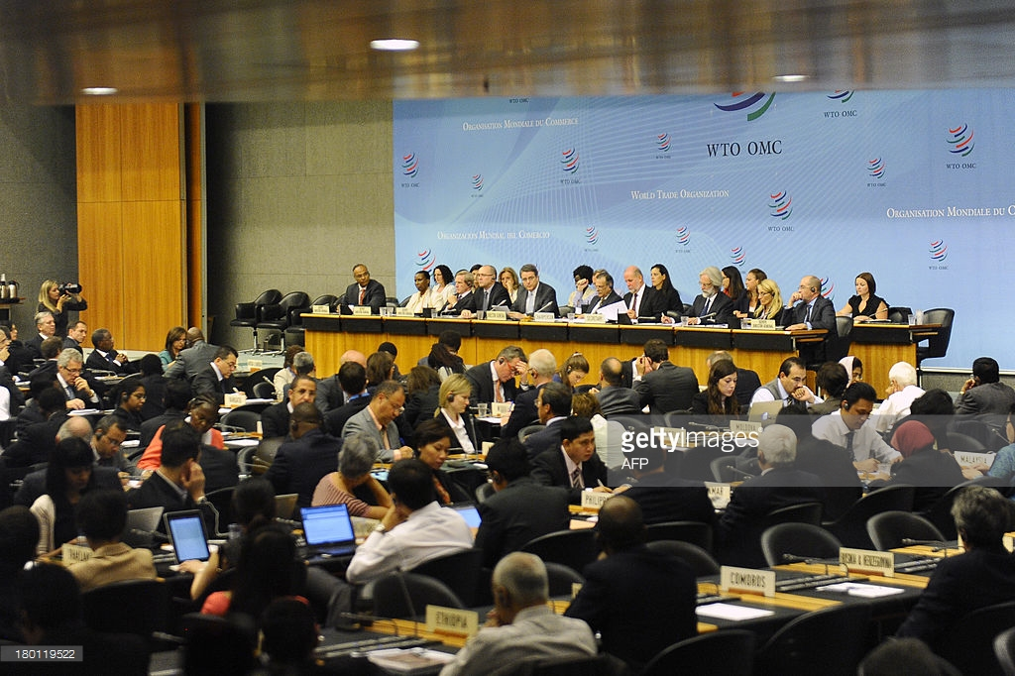
“WTO Paper on MRLs: How does it address missing MRLs”
Context of MRL Work in WTO
Kenya/Uganda/US Joint Recommendations
Leveraging the Joint Ministerial Statement at MC11
Next steps

Slide 3
Context in WTO SPS Committee
EU Hazard-Based Pesticide Policies
  Broad impact across Members of potential withdraw of MRLs
India Paper on “Levels of Detection”
  Members indicate current impact of missing MRLs significant
SPS Workshop on MRLs
  Experts report on work underway & challenges to address

Slide 4
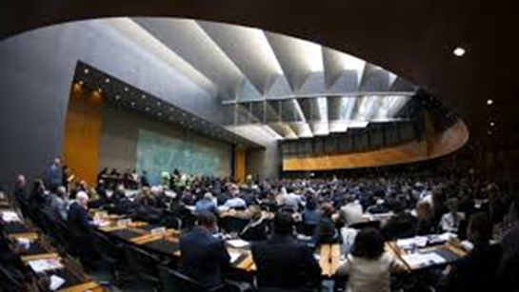
Goals of Joint MC11 Statement
  Consolidate anti-hazard coalition with forward positive work program
  Put forward recommendations to spur momentum on expert work
  Reframe narrative to larger context of shared goals on trade and development (e.g., enabling access, IPM, rural incomes, etc.)
  Obtain high-level endorsement to leverage effective change

Slide 5
Delivering on Joint MRL Recommendations
  Enable JMPR to Better Respond to Increased Demand and Monitor Progress on New Codex MRLs
  Strengthen Notification Practices for Greater Transparency and Predictability on MRLs
  Expand Reporting to the Committee on International and Regional Activities on MRLs
  Collaborate on Solutions for MRLs for Minor Use and Specialty Crops
  Strengthen Role of the Committee in Increasing Coordination and Harmonization

Slide 6

Role of WTO
WTO Agreements provide relevant rules, particularly risk and science based regulatory approaches frameworks
WTO bodies, including Ministerial Conference, provide platforms for discussion, awareness raising and coalition building
  Delivering on joint MRL recommendations requires international/regional advocacy

Slide 7
Next Steps in WTO on MRLs
  Kenya, Uganda & US submit recommendations to Committee under Fifth Review of Operation & Implementation of SPS Agreement
  Use Committee for reporting/monitoring implementation of recommendations
  Continue to monitor Member notifications on MRLs
  Advocate for adherence to international standards/risk assessment/scientific principles in setting MRLs

Slide 8

Enabling Farmer Access to
Safe Tools & Technologies
Joint MC11 Statement set MRL work in larger context: Negative impact on rural incomes and food security
Called out the need to address unwarranted regulatory barriers to access to tools & technologies
Need positive initiative for collaboration on streamlining regulatory approaches to pre-market approval and inspection systems.

Slide 9
Thank You
Julia Doherty
Jdoherty@ustr.eop.gov
202-395-9559

