Slide 1
Economic Impact of Missing MRLs: The Case of Eastern Africa By Kimwaga Mhando Trade Policy Analyst, Eastern Africa Grain Council
Presentation at the
Government-industry Workshop on Missing MRLs
February 26, 2018
World Trade Organization’s Centre William Rappard, Geneva, Switzerland

Slide 2
Outline of Presentation
Introducing EAGC
Eastern Africa’s grain trade with RoW
Policy framework for MRLs in ESA
Why MRLs are important for EA grain sector
Recommendations

Slide 3
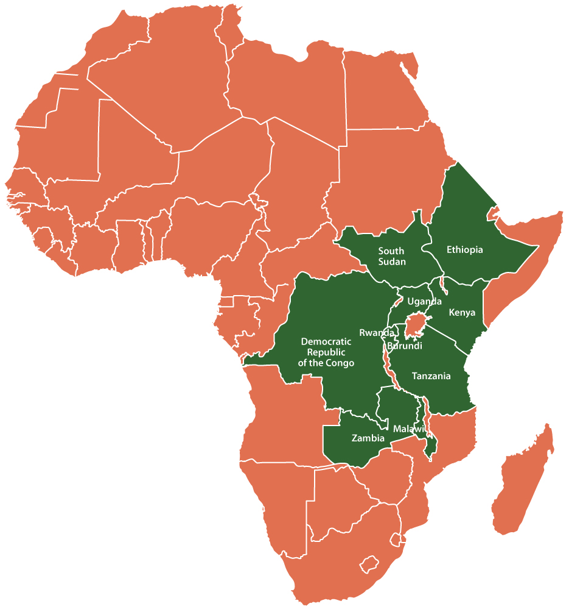
1. Introducing EAGC
Regional, non-profit, membership based organization for the Grain value chain in the Eastern and Southern Africa
Established in 2006
Objective: To facilitate efficient, structured, inclusive &profitable grain trade in the Eastern Africa region

Slide 4




EAGC Service Pillars

Slide 5
2. Eastern Africa’s grain trade with RoW
Key food grains are maize, wheat and rice
Minimal exports of these commodities outside ESA.
Significant net imports of wheat and rice despite local production capacity
Pulses are important export commodities, with key market being India

Slide 6
Intra & extra-regional maize trade
Source: UNCOMTRADE
Notes:
Negligible trade in Maize with RoW

Slide 7
Rice trade with Row
Sample of Ethiopia, Kenya, Tanzania, Uganda and Zambia. Source: UNCOMTRADE
Notes:
Rice trade is dominated by Asia; approx. $500 million worth of rice imports from Asia into East Africa annually.
For wheat, over 80% of wheat is imported mostly from Eastern Europe

Slide 8
Chickpea trade with RoW
Source: UNCOMTRADE
Notes:
Extra-regional trade (particularly exports) dominate pulses trade

Slide 9
Chickpea trade distribution
Source: UNCOMTRADE

Slide 10
Factors impeding stronger grain trade with RoW
Production systems in ESA not very competitive
Structural issues (smallholder-dominated production, low mechanisation, limited use of good inputs)
Barriers to trade, dominance of informal trade
Agricultural policies outside ESA
Export subsidies e.g. Thailand rice
EU Common Agricultural Policy
International trade policies (SPS/TBT matters)
Notes:
EU CAP provides EUR 58 billion worth of subsidies to farmers

Slide 11
3. Policy framework for MRLs in ESA
EAC SPS Protocol and Bill
EAC Harmonised Staple Foods Standards
COMESA Mutual Recognition Framework
Notes:
EAC Standards:
Applicable in 6 EAC partner states; Cover 22 commodities/products; 2 standards for sampling and test methods; Developed in consideration of CODEX and ISO standards; The standards make reference to CODEX standards on matters relating to MLs/MRLs
Reference to CODEX General Standard for Contaminants and Toxins in Food and Feed (CXS 193-1995)

Slide 12
MRL-related challenges in ESA
Tropical environment highly conducive for pests
Region prone to pest outbreaks annually
Pests prevalent at all levels – from farm to storage
Recent introduction of new pests,
e.g. the fall armyworm from South America
New pests may require new pesticides…have they been registered and their MRLs established in export markets?
These necessitate increased pesticide use but:
Testing capabilities for MRLs are limited
High cost of testing
Movement towards hermetic storage and certified warehouse

Slide 13
4. Why MRLs are important for EA grain sector
To guide good agricultural practice w.r.t. correct use of agro-chemicals
Grain-producing plants pass through a vegetable state, and some consumption takes place at this level. E.g. green maize, baby corn, sweet corn, fresh beans, etc. MRL risks higher at this stage
To improve competitiveness and market access
Missing and/or stringent MRLs mean that only few companies are able to export, essentially creating an export cartel which undermines the domestic farmers.
Notes:
E.g. in 2014, 11 firms in Kenya had their licences to export to EU suspended. This affected 5,000 farmers under them
A small proportion of farmers have access to EU market. Only 10% of horticulture farmers have access to EU market
https://www.standardmedia.co.ke/business/article/2000131207/fresh-produce-farmers-firms-banned-from-eu
https://www.nation.co.ke/lifestyle/smartcompany/Boost-for-horticulture-exports-as-State-lab/1226-3049154-e9cn1j/index.html

Slide 14
To support market diversification
E.g. Opportunities to diversify exports of pulses
Increased consumer awareness of food safety
MRLs help to define what is safe, and will guide farmers to produce safe food for market
Going organic may be uneconomical for grain commodities and sub-products
Notes:
Pulses exports from EA mostly destined for India. Increases vulnerability to shocks in India (e.g. pigeon pea import ban 2017 to date)

Slide 15
5. Recommendations in setting missing MRLs
African voice in MRL-setting
Adequate representation at all levels of negotiation and decision-making
Wide stakeholder consultative process from country level to regional, continental and international levels
Business-friendly MRLs to be established

